Slide 1
Welcome to the Armstrong Wolfe EMEA & North America Symposium
The strategic value of outsourcing technology and non-differentiated operational activities
A fresh perspective on transformational change

Slide 2
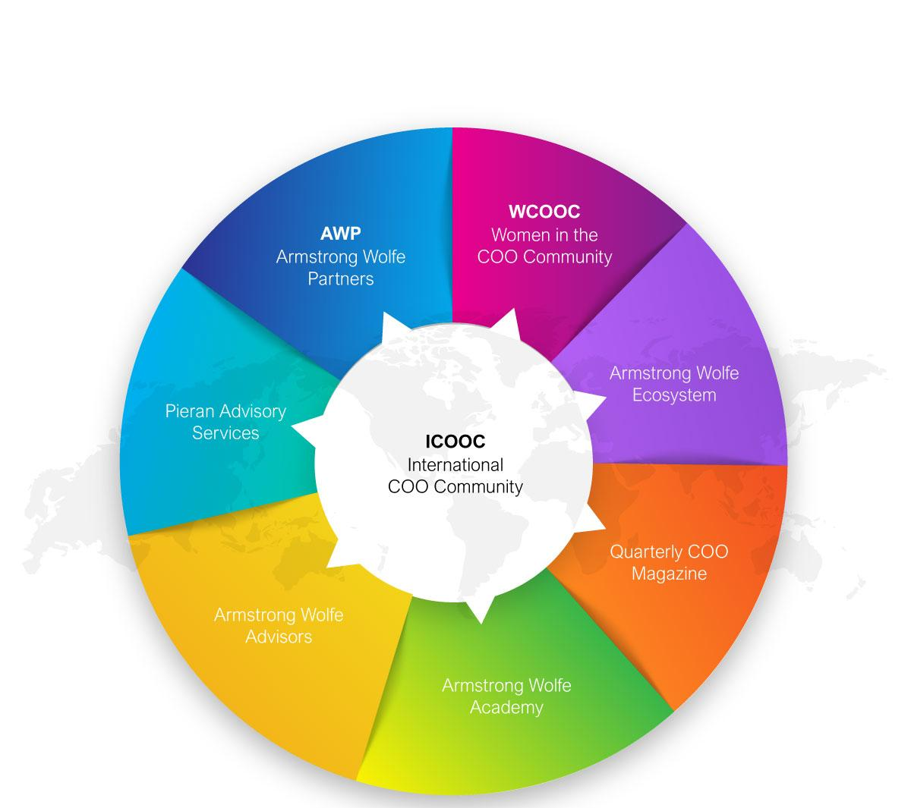
Armstrong Wolfe
A COO Advisory Firm
Empowering the Financial Services COO Community

Slide 3
Reinvigorating the debate and approach to outsourcing and the role of industry-wide collaboration
Stage 1
Symposium 1 and 2
Setting the Scene
Stage 2
Industry Panel Session
Dissecting identified Challenges
Stage 4
Collective feedback
The Path Ahead
Stage 3
Deep Dive Cluster Calls
New Perspectives

Slide 4
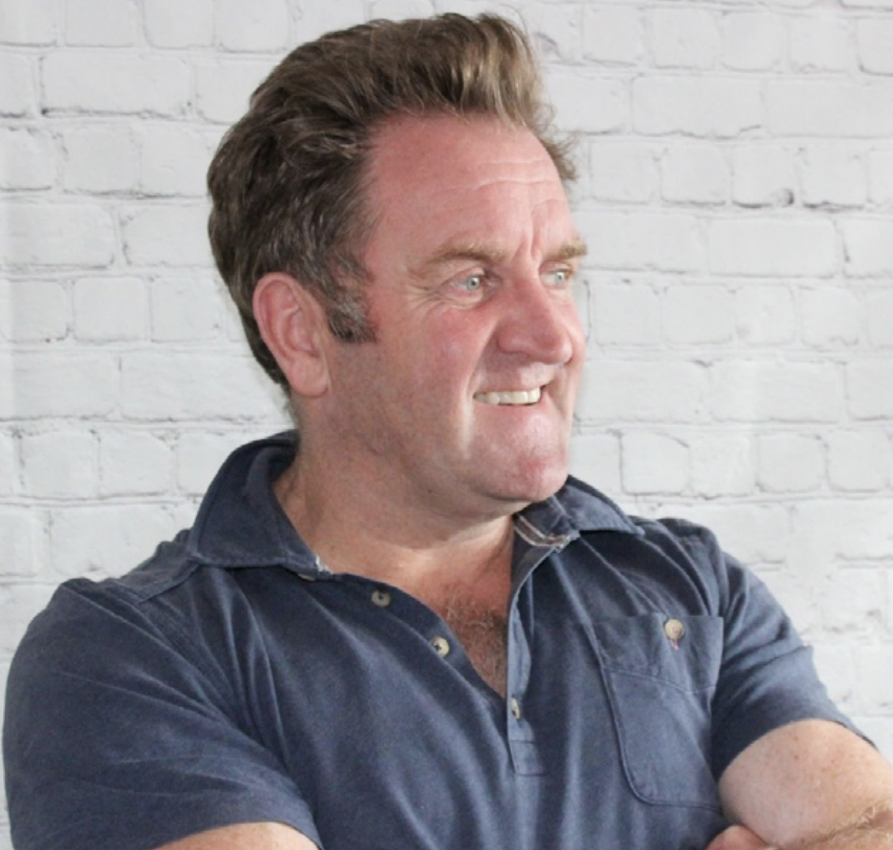
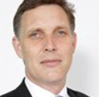
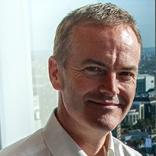
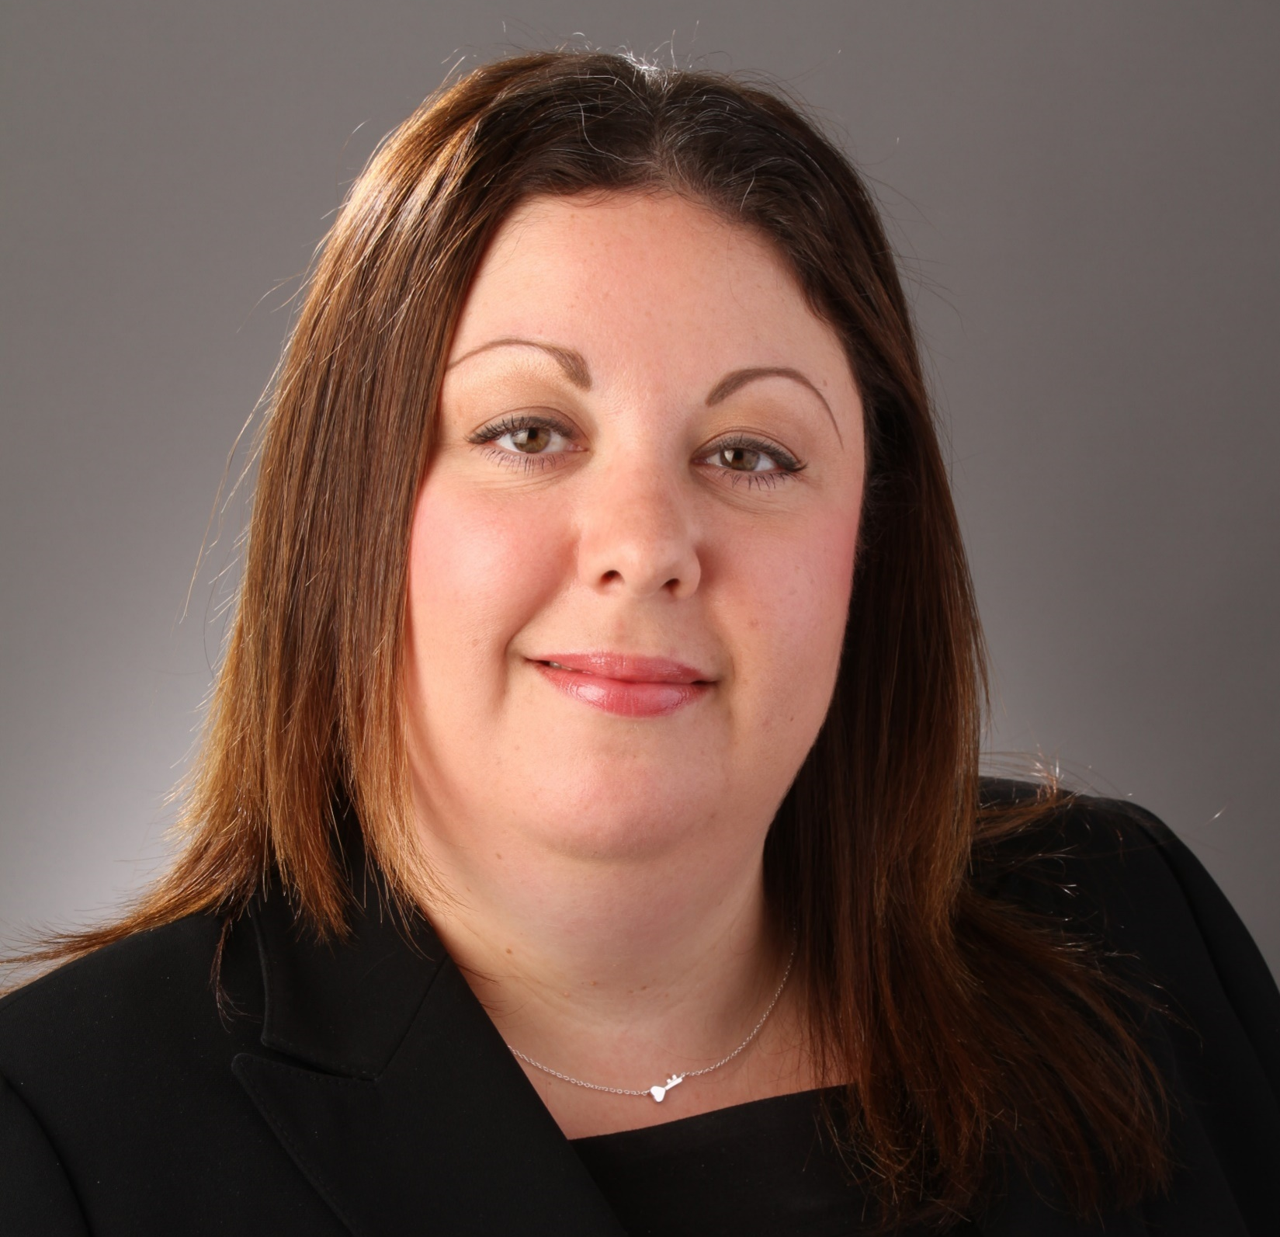
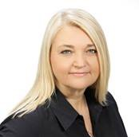
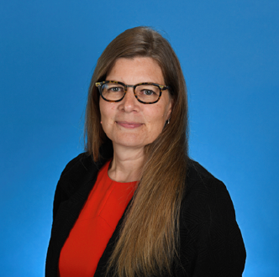
Speakers & Panellists
Speakers:
Moderated by:
Maurice Evlyn-Bufton
CEO
Armstrong Wolfe
Hugh Richards
MD, Products and Solutions
DXC Luxoft
Matthew Hargreaves
Global Industry Lead – Capital Markets Solutions
DXC Luxoft
Panellists:
Erica Benjamin
MD, Chief Administrative Officer Capital Markets
BMO Financial Group
Lisa Woodward
MD, Head of Operations
Mizuho Financial Group
Lori Messer
MD, Global Head of Capital Markets Business & Client Services
RBC Capital Markets

Slide 5
Thank You!
For more information visit www.armstrongwolfe.com
Find us on LinkedIn: Armstrong Wolfe | Women in the COO Community | Global COO Community

