Slide 1


Today’s Agenda
What is a Personal Brand and why do you need one?
What does a strong Personal Brand look like?
What makes up your Personal Brand?
Key Strategies to building a powerful Personal Brand

Slide 2

So, what is all the fuss about?
A Personal Brand is ‘a widely-recognised and largely-uniform perception or impression of an individual based on their experience, expertise, competencies, actions and/or achievements within a community, industry, or the marketplace at large’.
There is a difference between personal branding and your personal brand!
A Personal Brand helps you build trust, helps others understand you, it enables talent acquisition, it can create brand awareness for you and your company, it can help you command increased compensation, it opens up opportunities and it can build respect.
You have a brand whether you like it or not…!
You don’t have to turn into someone else to build you brand.
Notes:
Personal Brand has 2 parts – internal and external. We put way too much emphasis on the external in particular your social media presence.
You have a brand whether you like it or not…so make sure it’s a brand you want.
Brand should be distinctive

Slide 3
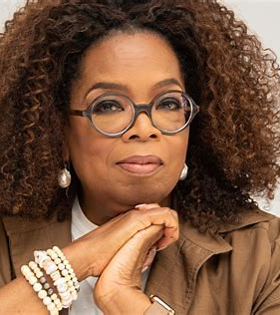
Oprah
Winfrey

Slide 4
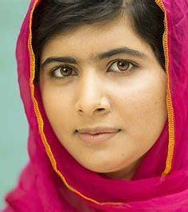
Malala
Youfsafzai

Slide 5
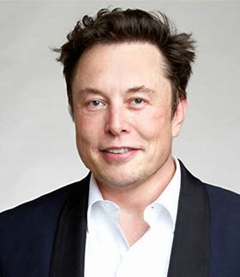
Elon
Musk

Slide 6







What makes up a Personal Brand?
The 7 Step Framework
Story
Passions
Values
Skills and
Experience
Behaviour
and Actions
Communication
Image

Slide 7
What does a strong Personal Brand
look like?
Authentic
Focussed
Differentiated
Well understood
Consistent
Widely Known

Slide 8
Key Strategies
How do you build a strong Personal Brand?
Hone your story – 3 major transitions work
What are you passionate about? How does this translate into work?
What are your values – 10 Top Values exercise
Do a strengths and experience audit
Do you live your values? How does your behaviour reflect what’s important to you?
When did you last update your CV?
Do you have a social media presence?
Weave in your stories when talking to people
Get out there!! Do townhalls, speaker series
Use ‘executive’ language
Dress for the role you want, not the role you have

Slide 9
Executive Coaching at Armstrong Wolfe
In order to support our mission to professionalise the COO community, we offer Executive Coaching
70% of individuals who receive coaching benefit from improved work performance.* Benefits include:
  Increased self awareness
  Greater self confidence
  Improved capability
  Better communication skills
We help our clients achieve promotion, negotiate better working terms and conditions, successfully transition into larger roles, change careers and become more confident and authentic in the workplace
For more information please contact c.Hamilton@armstrongwolfe.com or visit our coaching page at Executive Coaching - Armstrong Wolfe | Financial Advisory
*International Coaching Federation: Global Client Study - 2009

Slide 10
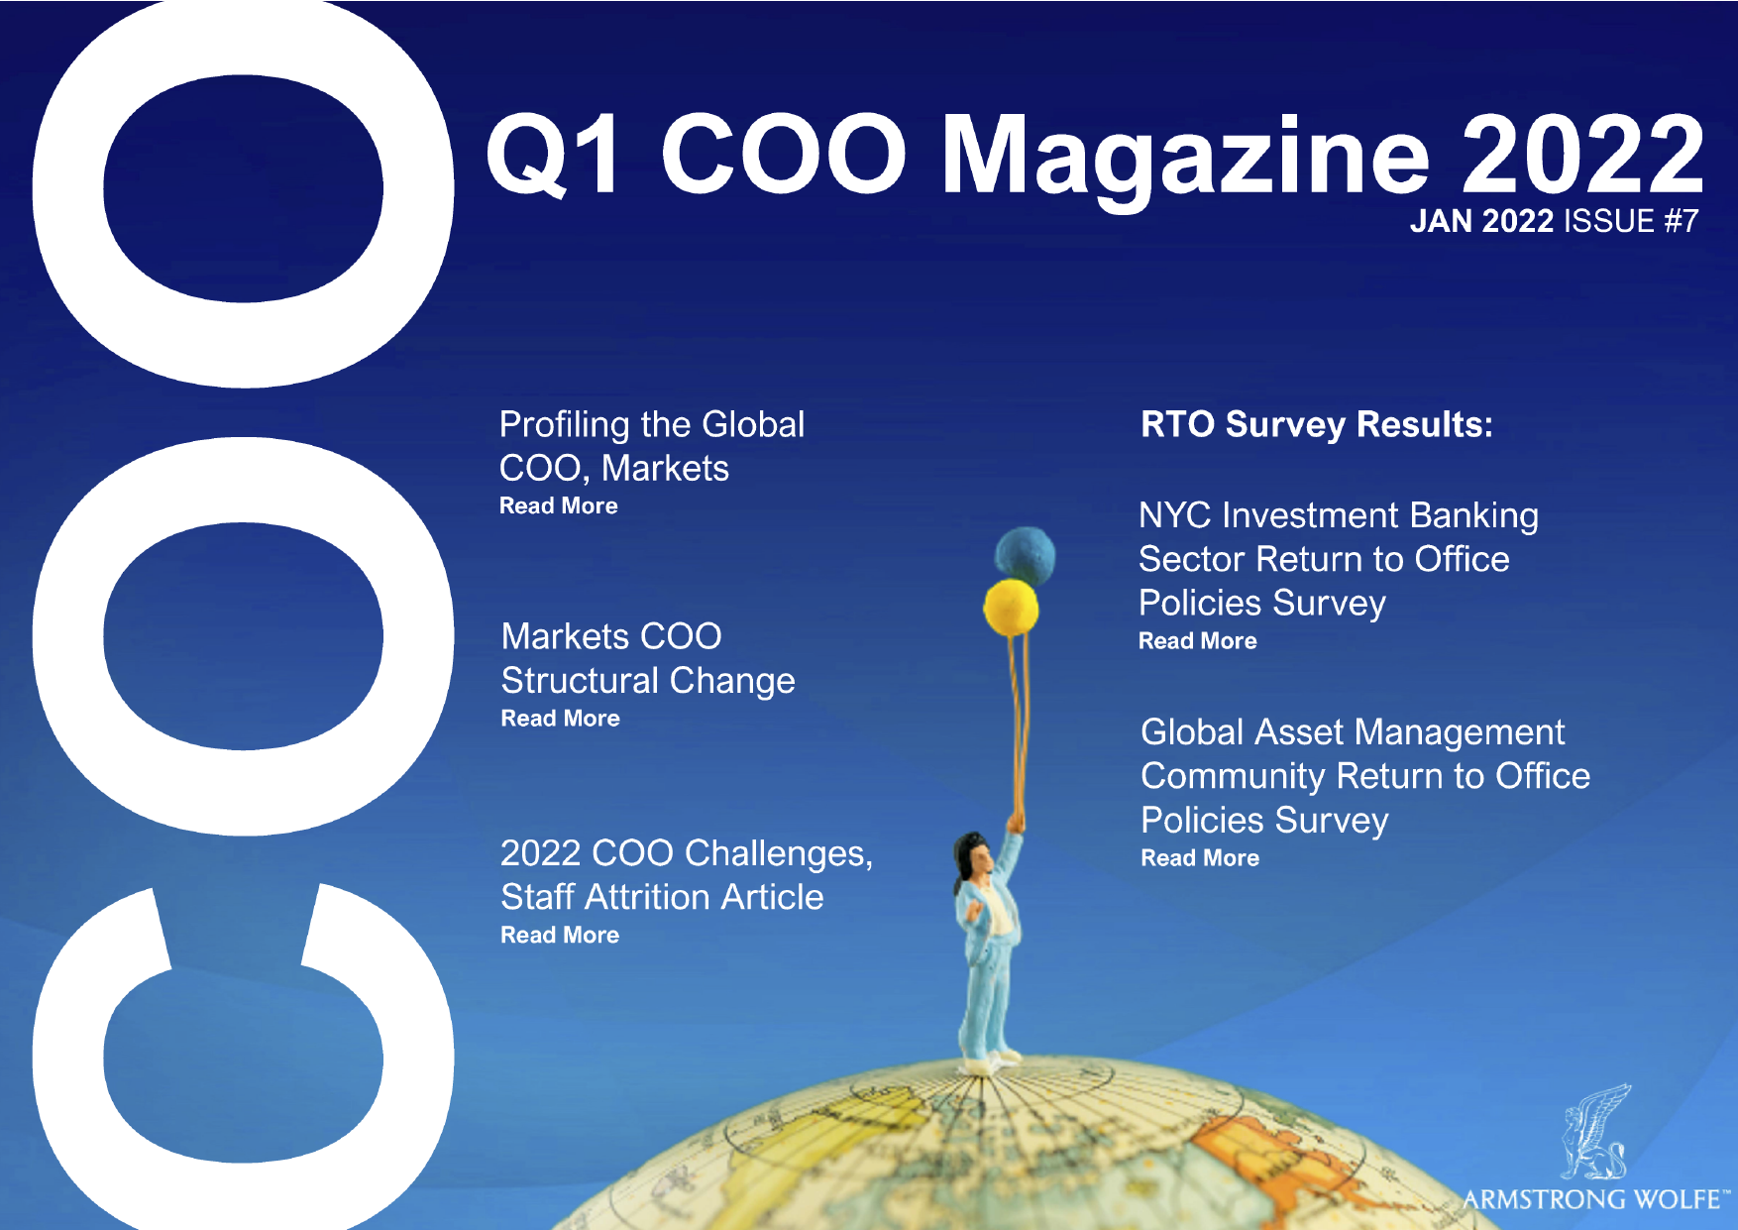

Thank You!
Dates for your diary:
The Essential Coaching Techniques you Need to Know to be a More Effective Leader - 5th April 2022 APAC/ EMEA, 6th April 2022 NA/ EMEA
Conduct and Culture Summit - 27th April 2022
For more information visit armstrongwolfe.com
Q1 Magazine 2022
OUT NOW!
Have you read the Q1 COO Magazine?
armstrongwolfe.com/library/coo-magazine/
Find us on LinkedIn: Armstrong Wolfe | Global COO community platform

