Slide 1
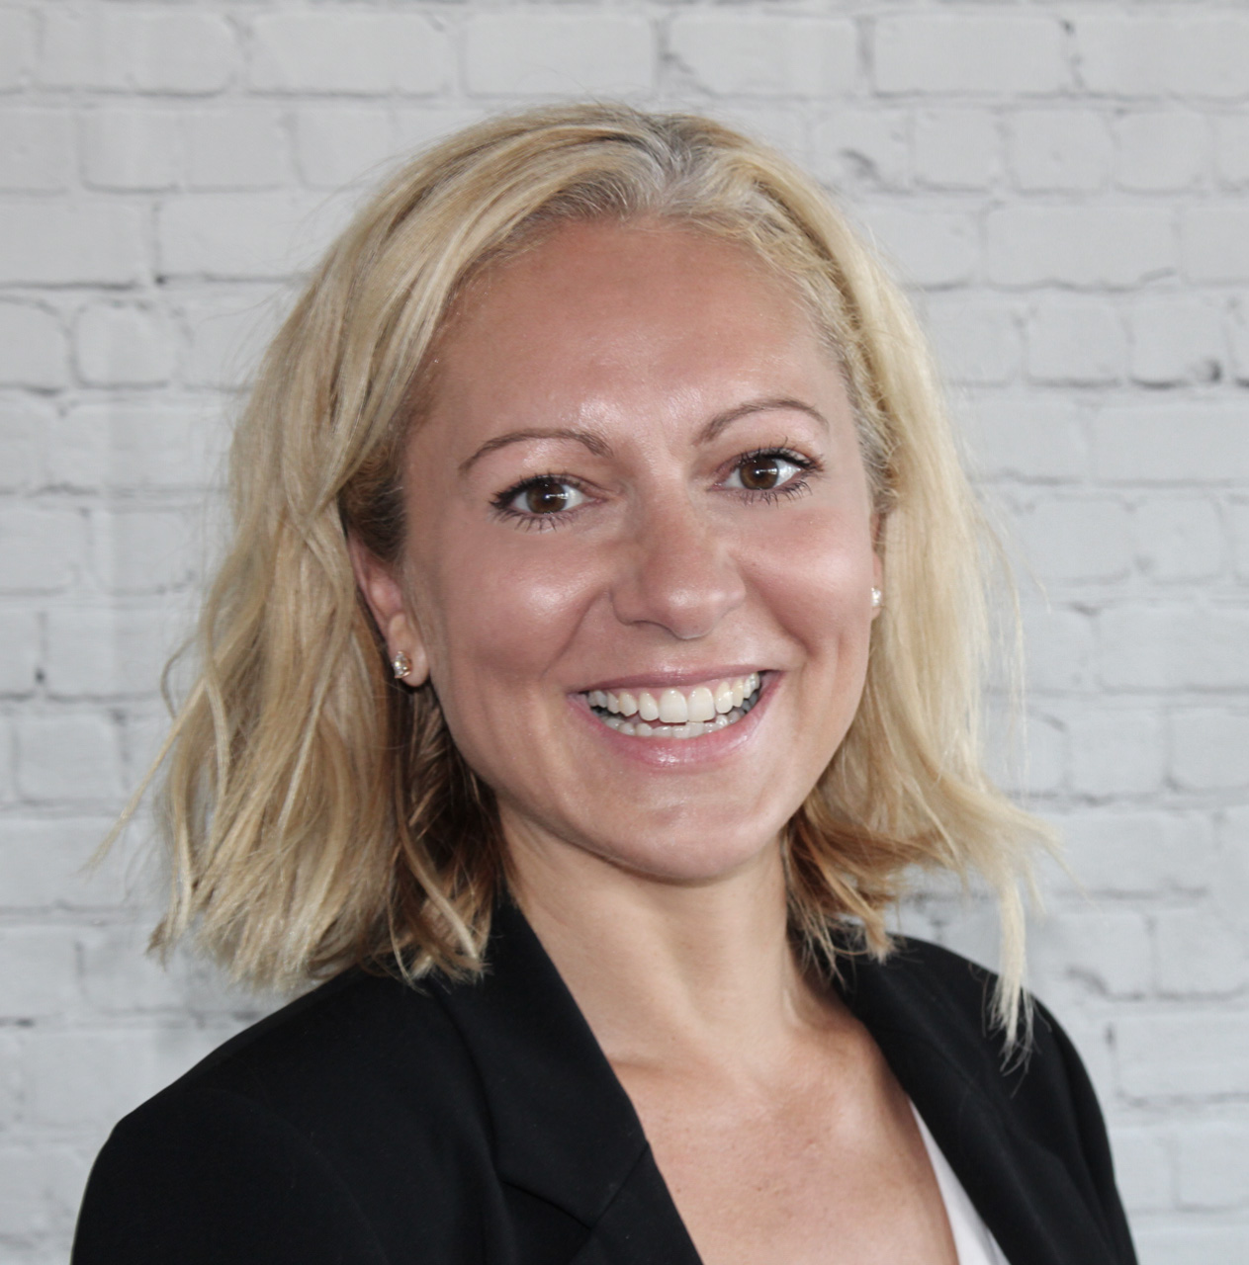
Welcome to the WCOOC
Mentoring and Sponsorship:
How to Leverage and Manage Your Network
Moderator
Gwen Wilcox
COO
Armstrong Wolfe
Speaker
Cressida Hamilton
Executive Coach
Armstrong Wolfe

Slide 2
Today’s Agenda
Mentoring versus Sponsoring – what’s the difference?
What should you look for in a Mentor?
What should you look for in a Sponsor?
How do you get one? How to secure a great mentor and / or sponsor
What is expected of you to make the relationship work?

Slide 3
Mentorship
Vs
Sponsorship
Mentors have Mentees
Offer guidance on career success
Provide input on how to build skills and capabilities
Help craft a career vision
Help mentee ‘skill up’
Give suggestions for career advancement and opportunity awareness
Support the mentee in how to increase visibility
Share the ‘unwritten rules’ for advancement within the organisation
Sponsors have Protégés
A senior level staff member invested in the protégés career success
Promote the protégé directly and connect them to assignments and people to build skills and capabilities
Drive the protégés career vision
Help protégé ‘move up’
Personally invested in the upwards movement of the protégés career
Champion their protégés visibility using their own platforms as a medium
Actively involves protégés in experiences that enable advancement

Slide 4
What Should You Look For in a Mentor?
What specifically do you want from a Mentor?
Relevant experience – ideally 4+ years more experience than you in a similar field
Knowledge
Willingness and enthusiasm
Capacity!
Strong interpersonal skills
Right mentor = right situation and right time. A mentor doesn’t have to be for life!
You can have more than one.
Watch out for:
Picking someone senior / obvious
Beliefs, bias and baggage

Slide 5
What Should You Look For in a Sponsor?
What specifically do you want from a Sponsor?
They should be powerfully positioned - ideally 2 levels above you in the organisation
Strong social capital within and outside of the organisation
Influence in your area of work
Organisational ‘clout’
Someone who will put their reputation on the line for you
Watch out for:
Don’t mistake competence for confidence
The relationship is not ‘for free’ as a protégé so be prepared to give back

Slide 6
How Do I Get a Mentor and / or a Sponsor?
Identification stage
Know who/what you want - map the potential roles out. Who/what roles fit the descriptions on pages 4 and 5?
Ask around
Raise your hand and ask for one
Have more than one option
If your organisation has a well run programme, find out what you need to do to get on it BUT don’t rely on it.
Be visible…sponsors sometimes find you!
Depending on the situation, don’t just look within your organisation
Introduction stage
Don’t go in cold – make sure there is a fit first
Be patient but persistent!

Slide 7
What is Expected of Me to Make This Work?
Have clear career goals
what is your next goal?
what are your strengths & where have you been successful?
where do you want to grow and why?
why do you want a mentor in general?
why do you want a particular mentor?
Have a mentoring or sponsoring ‘agreement’ – expectations, process, & desired outcomes.
Connect…often
Drive the agenda and the logistics
Be appreciative and give back

Slide 8
Executive Coaching at Armstrong Wolfe
In order to support our mission to professionalise the COO community, we offer Executive Coaching
70% of individuals who receive coaching benefit from improved work performance.* Benefits include:
Increased self awareness
Greater self confidence
Improved capability
Better communication skills
We help our clients achieve promotion, negotiate better working terms and conditions, successfully transition into larger roles, change careers and become more confident and authentic in the workplace
For more information please contact c.Hamilton@armstrongwolfe.com or visit our coaching page at www.armstrongwolfe.com/coo-institute/executive-coaching
*International Coaching Federation: Global Client Study - 2009

Slide 9
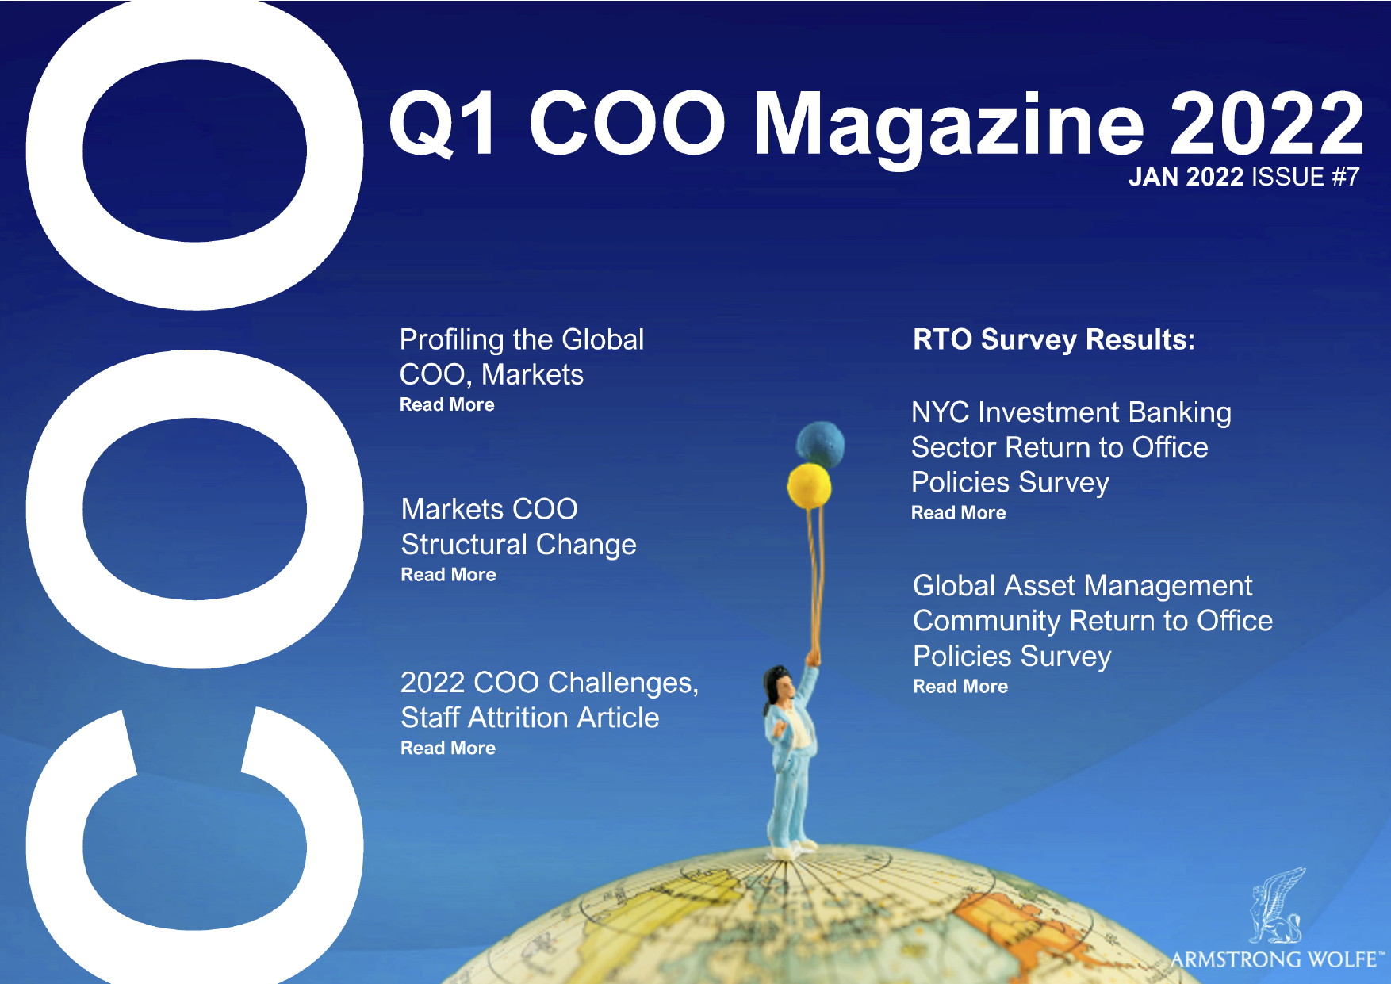
Thank You!
Dates for your diary:
The Essential Coaching Techniques you Need to Know to be a More Effective Leader - 5th April 2022 APAC/ EMEA, 6th April 2022 NA/ EMEA
Conduct and Culture Summit – 23rd June 2022
For more information visit armstrongwolfe.com
Find us on LinkedIn: Armstrong Wolfe | Global COO community platform, Women in the COO Community
Q1 Magazine 2022
OUT NOW!
Have you read the Q1 COO Magazine?
armstrongwolfe.com/library/coo-magazine/

